Slide 1

Worldwide Life Expectancy

Slide 2
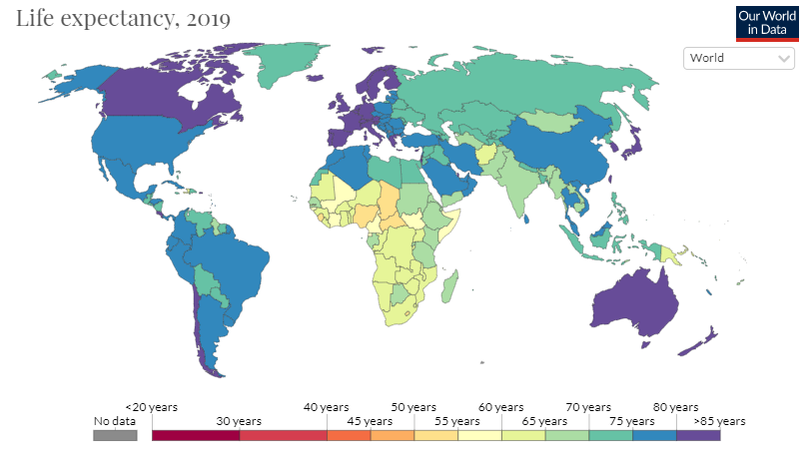
Why Life Expectancy?
Key metric in assessing overall population health
Huge variation among countries
47 years: Malwai
83 years: Japan
Important to address inequities & disparities
What factors have the greatest impact on average life expectancy?

Slide 3
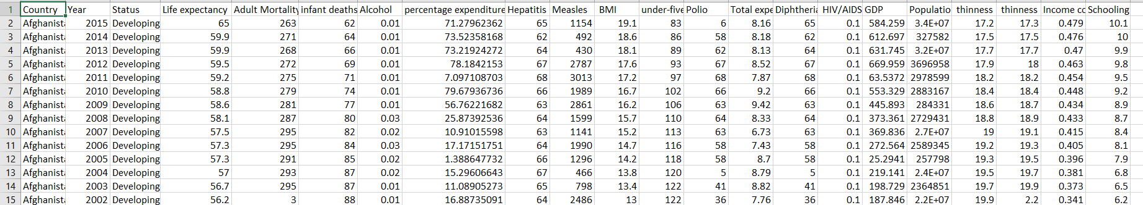
Our Data
“Life Expectancy Data Set” from kaggle.com
22 columns, 2,938 rows
WHO & United Nations data
Economic, health, social, political data for 193 countries from 2000 - 2015
Variables:
Country, population, BMI, economic status, percentage expenditure, polio, HIV/AIDS, GDP, schooling, etc.

Slide 4

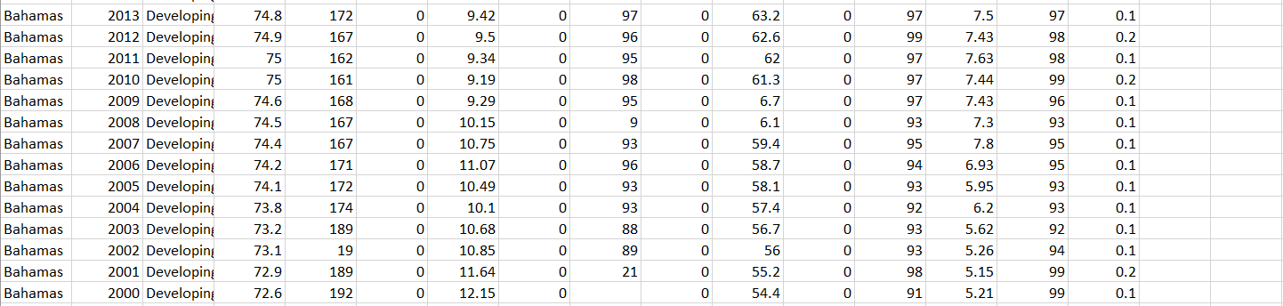
Data Preparation
Life Expectancy → target
All other variables set as input initially
Some missing values
Population, total expenditure, hepatitis b, alcohol, gdp, percentage expenditure, measles
Addressed with impute node in trial #2
Transformed variables

Slide 5
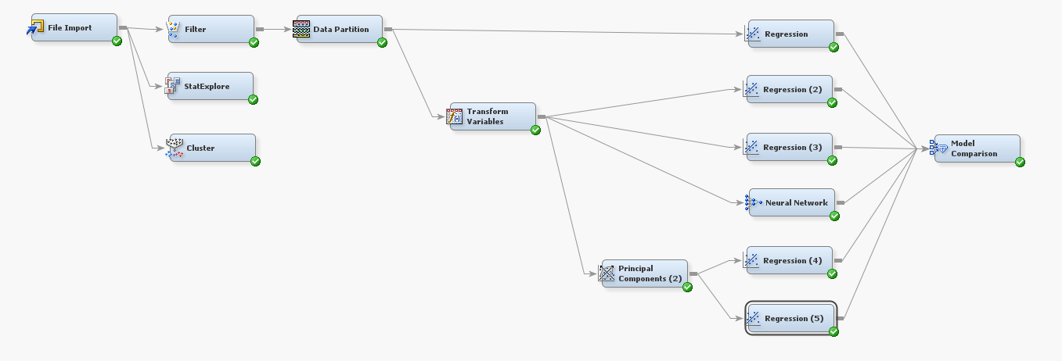
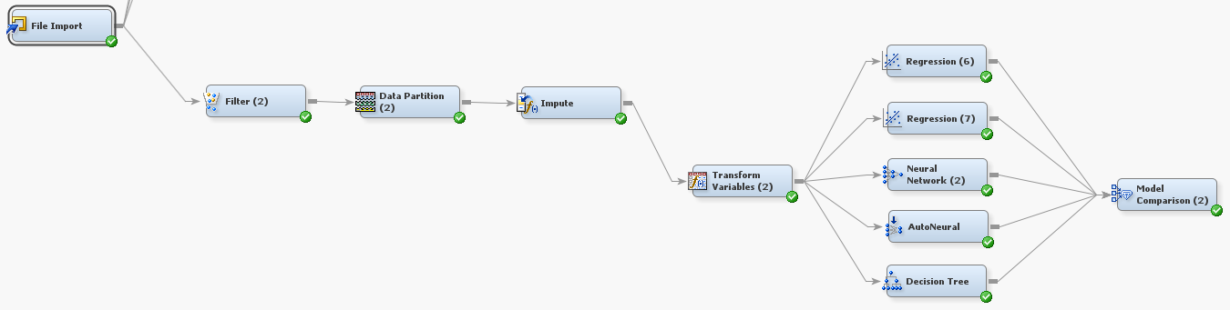
Diagram Overview
Trial 1
Trial 2

Slide 6
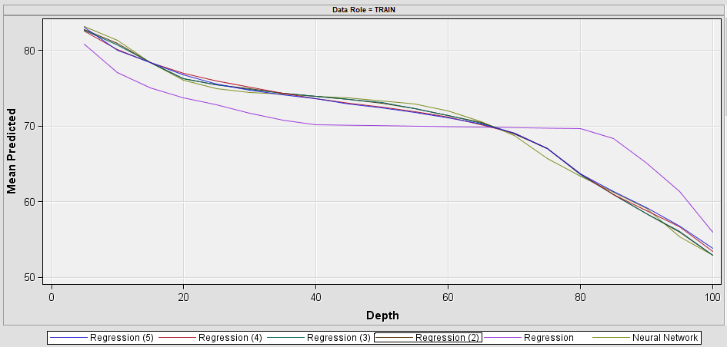
Trial 1 Findings
Did not impute data
Incorporated a Principal Component Analysis
Most Accurate: Neural Network
Based on Average Squared Error
Significant regression produced adjusted r-squared of .8719
Variables like Hepatitis B, Measles, and Alcohol were insignificant
Alpha level > .05
The PCA did not produce superior results to the regular
Adjusted r-squared was inferior
Average squared error was inferior

Slide 7

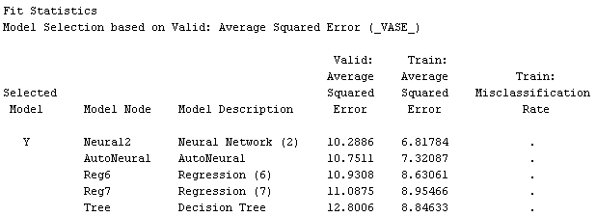
Trial 2 Findings
Imputed data but did not use PCA
Will the model improve with imputed data?
Outcome:
Model did not show significant improvement
Neural network produced best results
Adjusted r-squared of regression dropped by .18
Imputing was not found to show improvement of the models
Diagnostics:
Compute the models with the empty cells not having an impact
Use hard data from the countries to update base model

Slide 8
Significant Insignificant Relationships
Adult Mortality
Diphtheria
Income Composition
Polio
Population
Total Expenditure
BMI
Thinness 5-9 Years
Year
HIV/AIDS
Infant Deaths
Under 5 Deaths
Status
Alcohol
GDP
Hepatitis B
Schooling
Thinness 1-19 Years
Measles
Percentage Expenditure
Health metrics
Deadly diseases
Child healthcare
Healthcare spending
Economic Development Status

Slide 9
Conclusions
Countries should follow certain procedures to increase life expectancy:
Constant monitoring of health metrics and deaths
Important resources should be allocated to deadliest diseases
Stress importance of healthcare for children and infants
Increase expenditures on healthcare on a yearly basis
Aid developing countries in providing healthcare resources & necessities to citizens
Further measures:
Continue to manage the diseases that have dissipated
Find the right variables to collect and the right way to do it
Understand that some variables are still important, just not for lifespan

Slide 10
References
How different factors have an influence on your life expectancy | by Mubarak Ganiyu | Towards Data Science
Life Expectancy - Our World in Data
WHO | Fact file on health inequities
https://www.kaggle.com/kumarajarshi/life-expectancy-who

